Slide 1
LANDLORD
A mobile game made by Group 01

Slide 2




MEMBERS – G01

Slide 3
GAME CONCEPTS
The first version of landlord

Slide 4
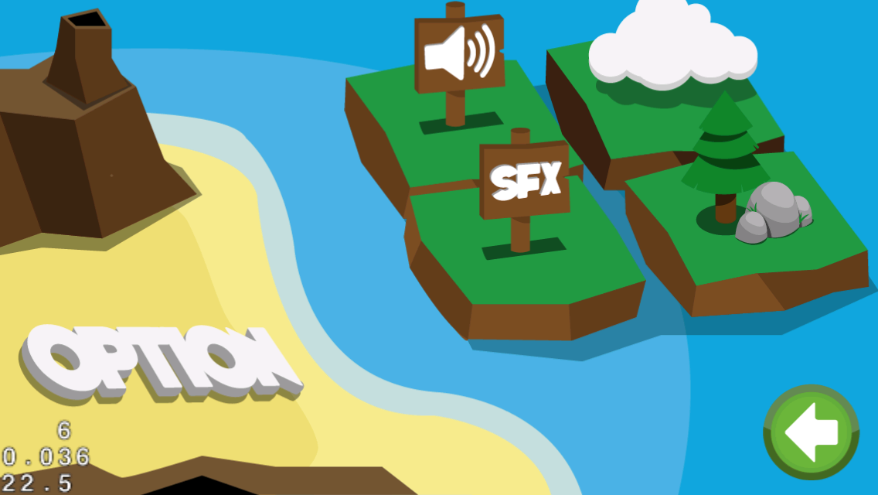
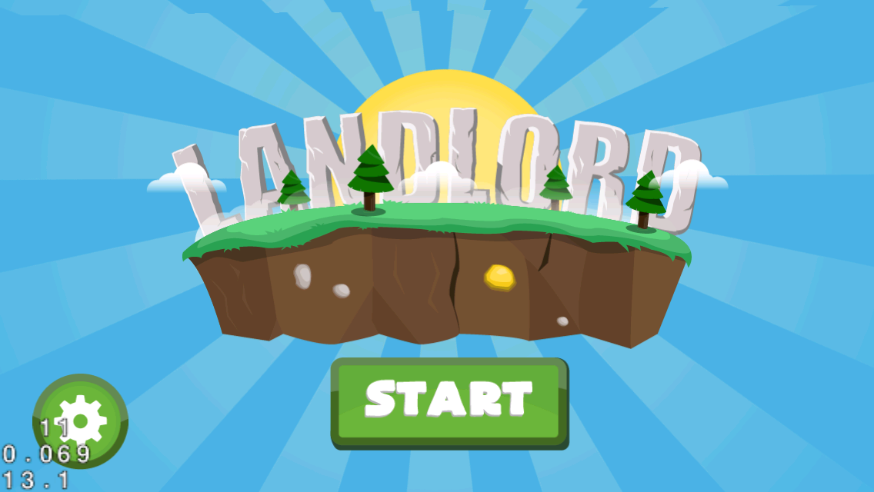

Slide 5
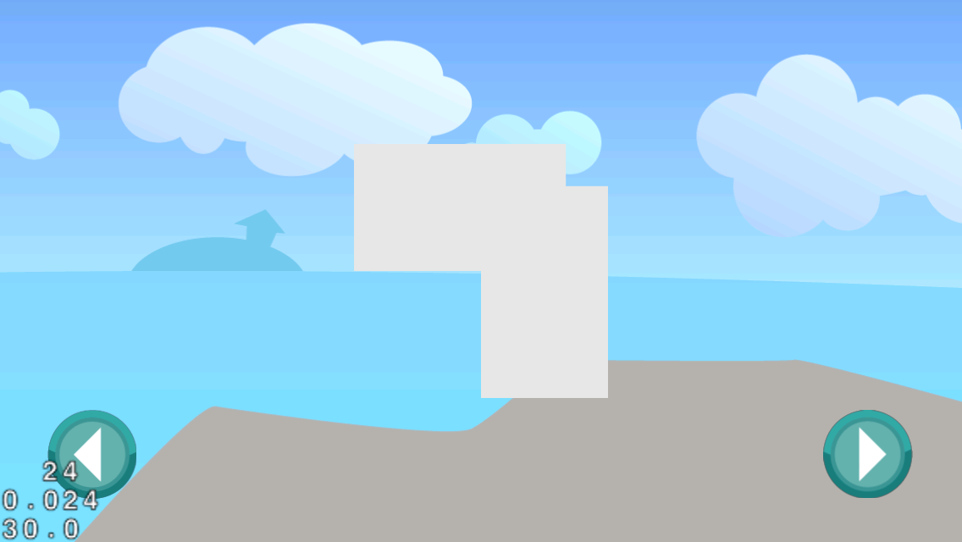


Slide 6
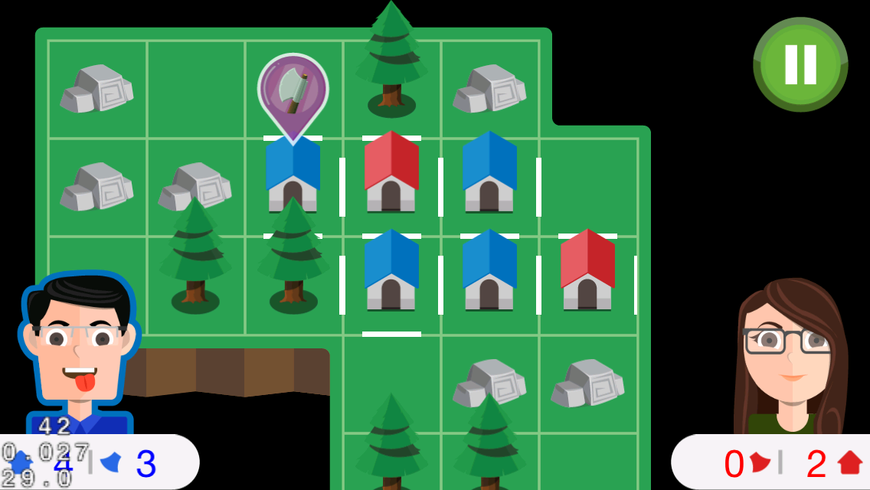
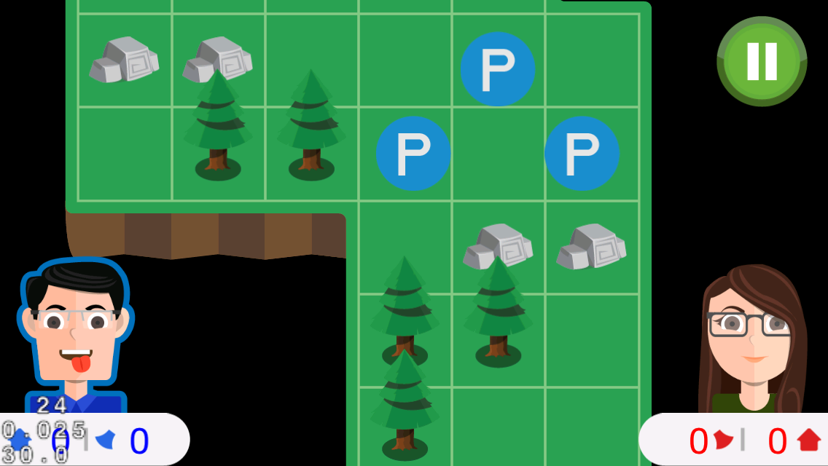

Slide 7
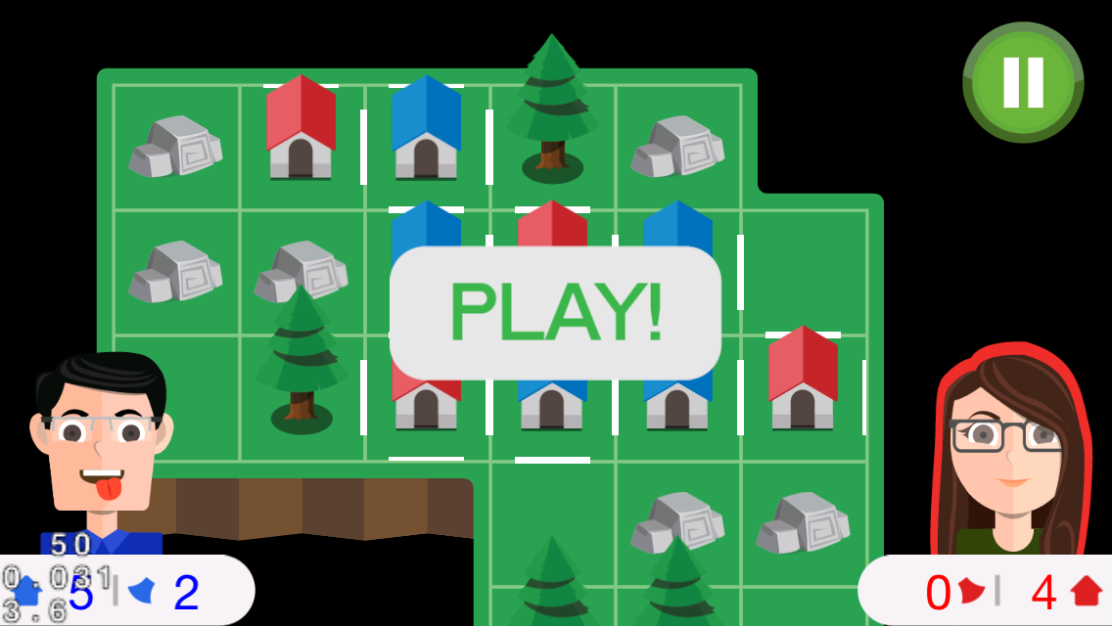


Slide 8
IDEA
inspired by a game on paper
a board game
2-player
FUN and COOL

Slide 9
GAMEPLAY
two players compete with each other
build houses and occupy the islands
tree mode, axes, …
https://github.com/tranvictor/landlord/ wiki

Slide 10
CONTROL
touch on tiles!
choose the edge to put fence
special tiles with hidden axe, tree, stone !
collect axes
use axe to cut trees

Slide 11

COCOS2D-X
An awesome framework for making cross platform mobile games

Slide 12
PROJECT MANAGEMENT
pivotaltracker.com/s/projects/1031608

Slide 13
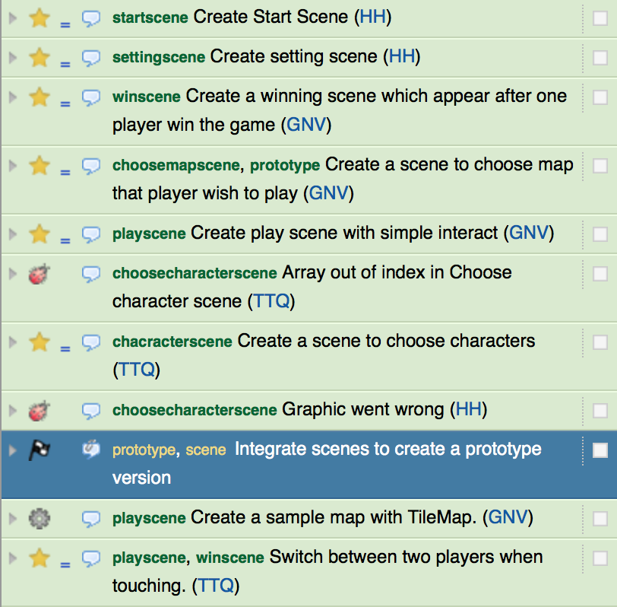
PIVOTALTRACKER

Slide 14
REVISION CONTROL AND SOURCE CODE MANAGEMENT
github.com/tranvictor/landlord

Slide 15
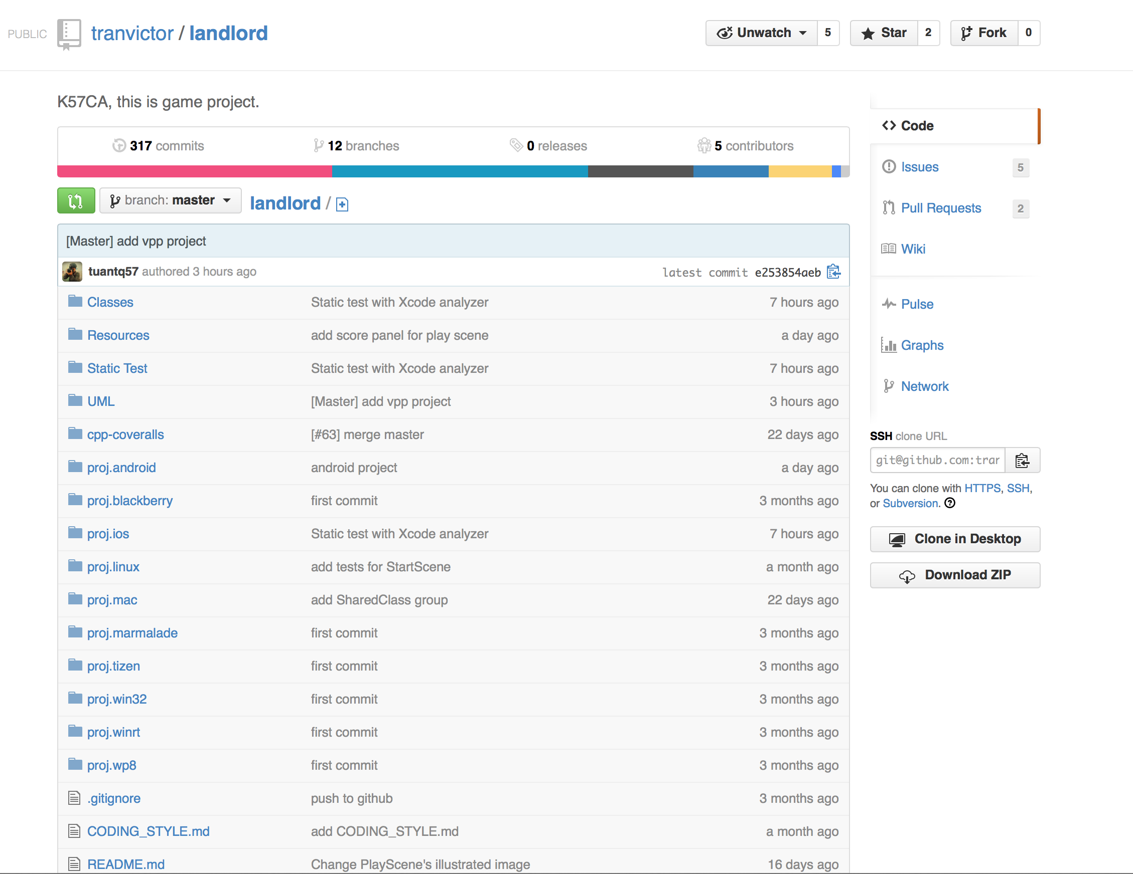
GITHUB REPO

Slide 16
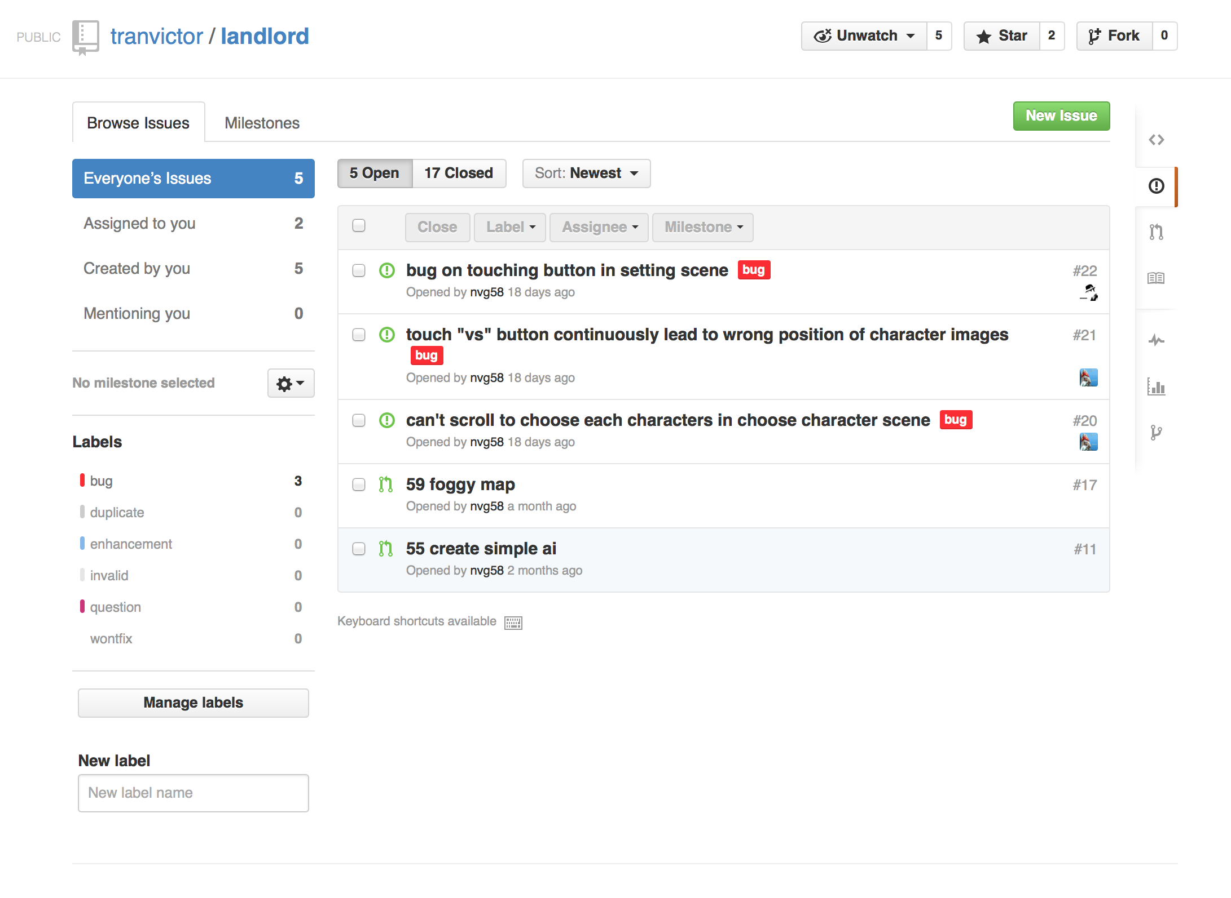
BUG TRACKING

Slide 17
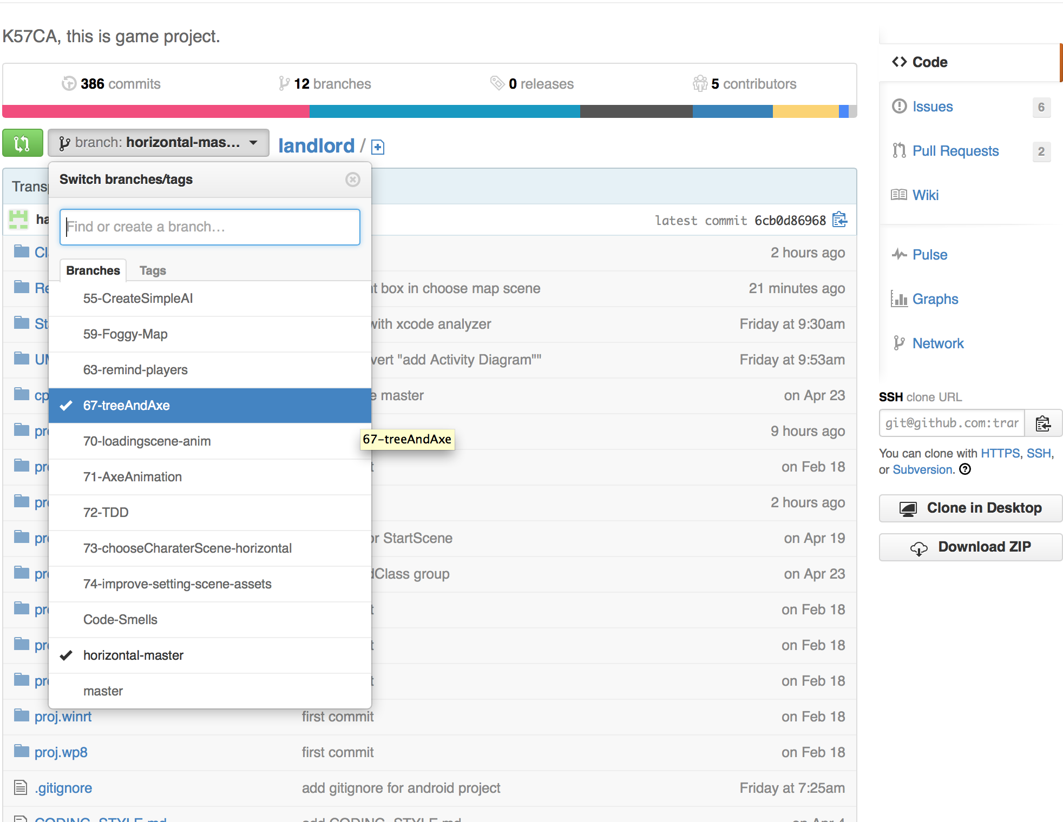
GIT WORKFLOW

Slide 18
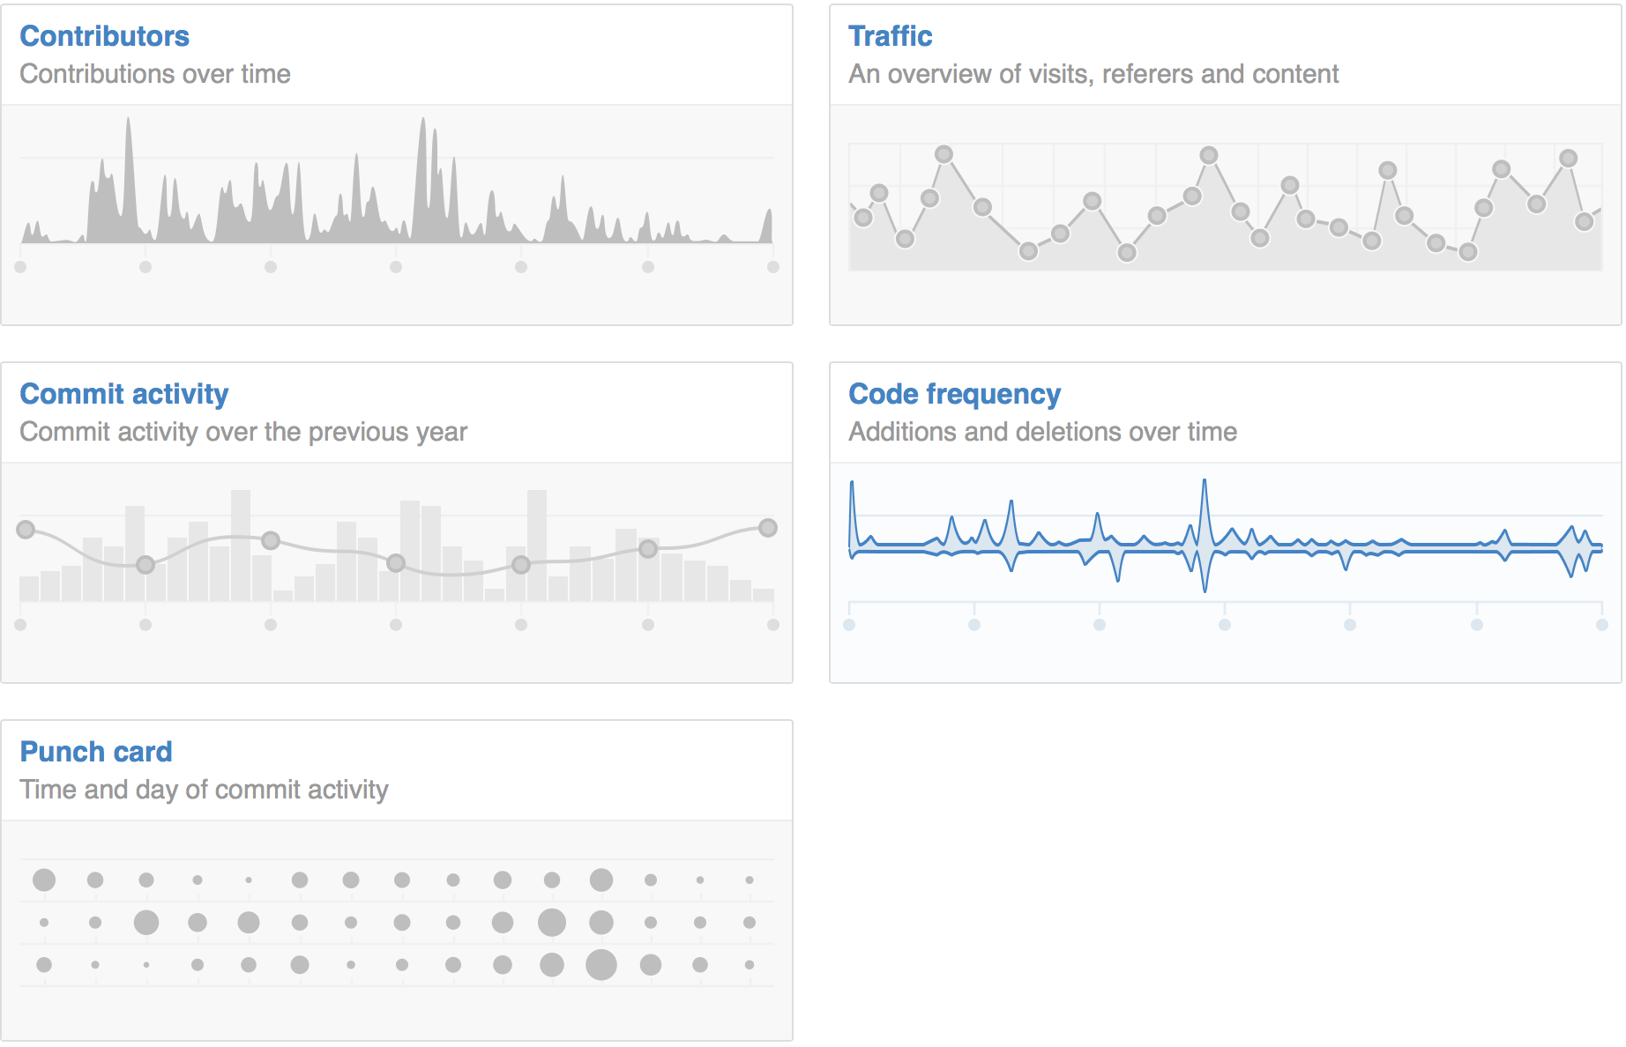
STATISTICS

Slide 19
SOFTWARE DEVELOPMENT PROCESS
Using Test-driven development (TDD)

Slide 20
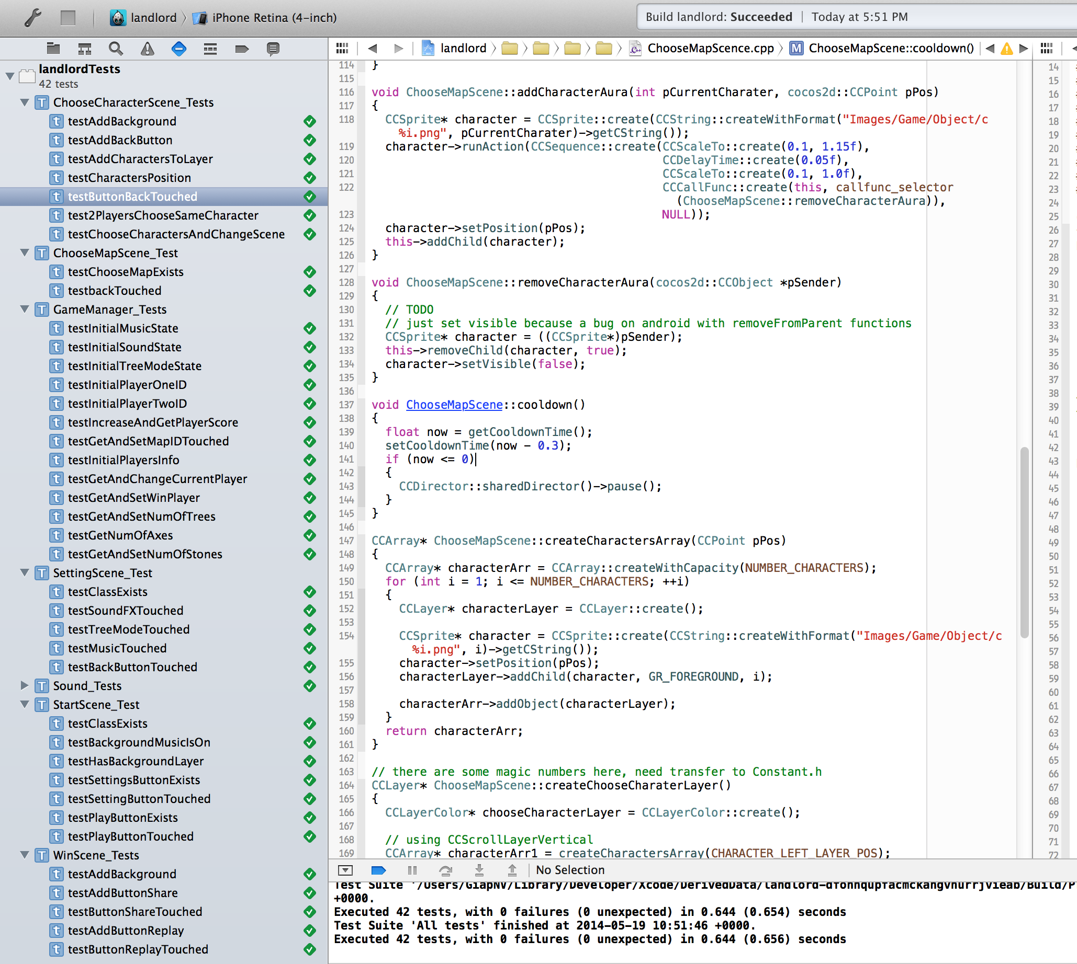
SENTESTINGKIT

Slide 21
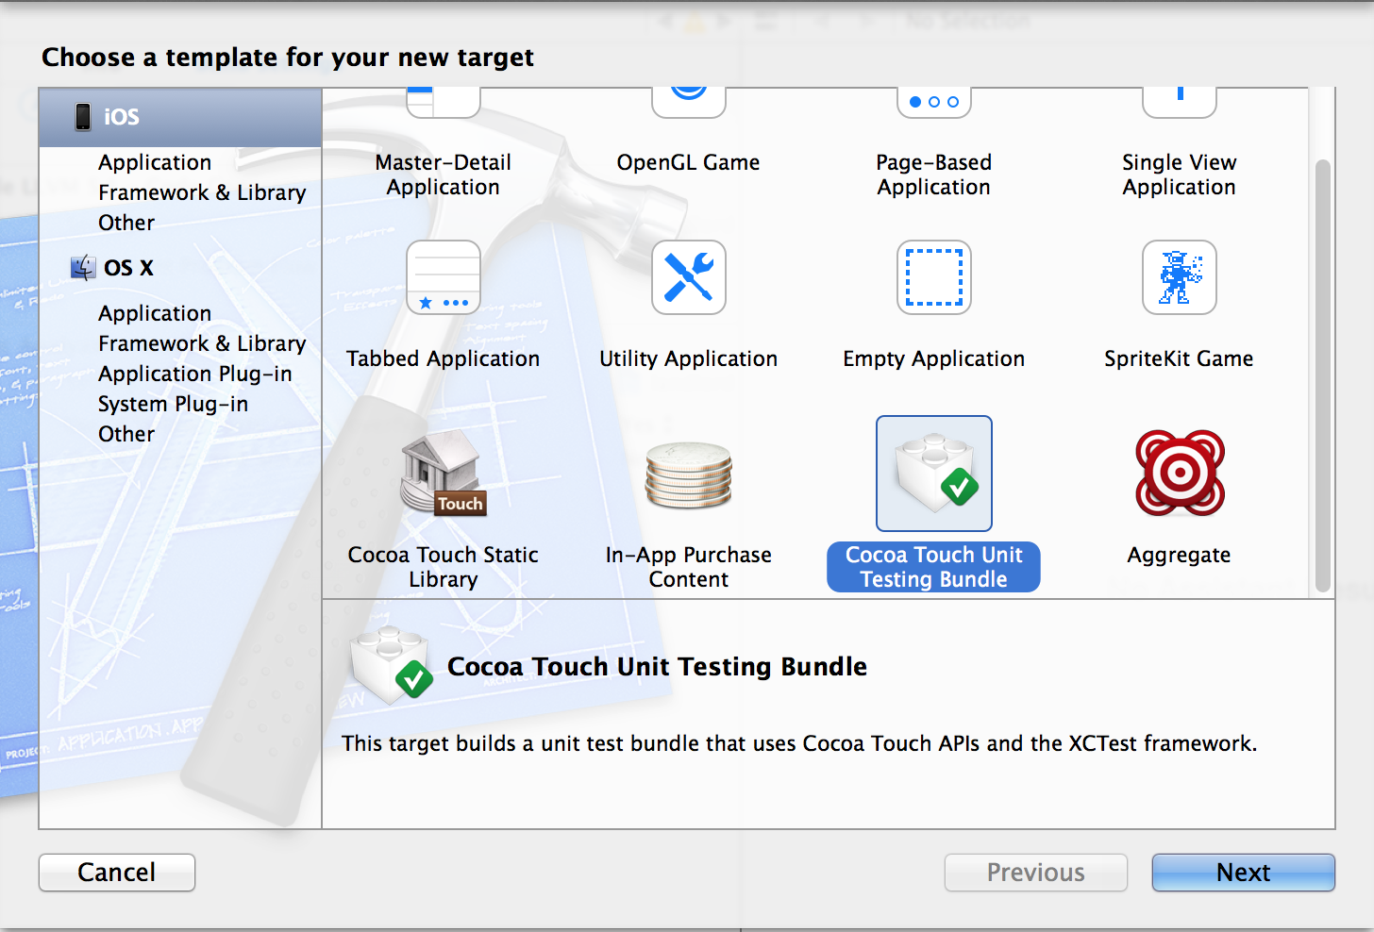
COCOA TOUCH UNIT TESTING

Slide 22
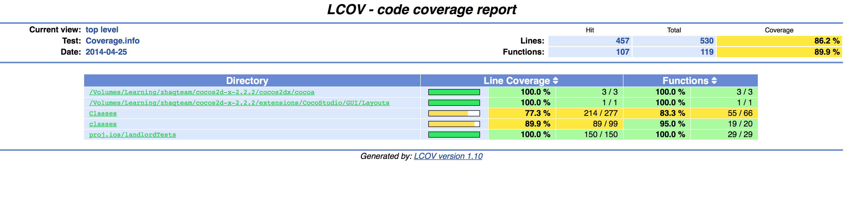
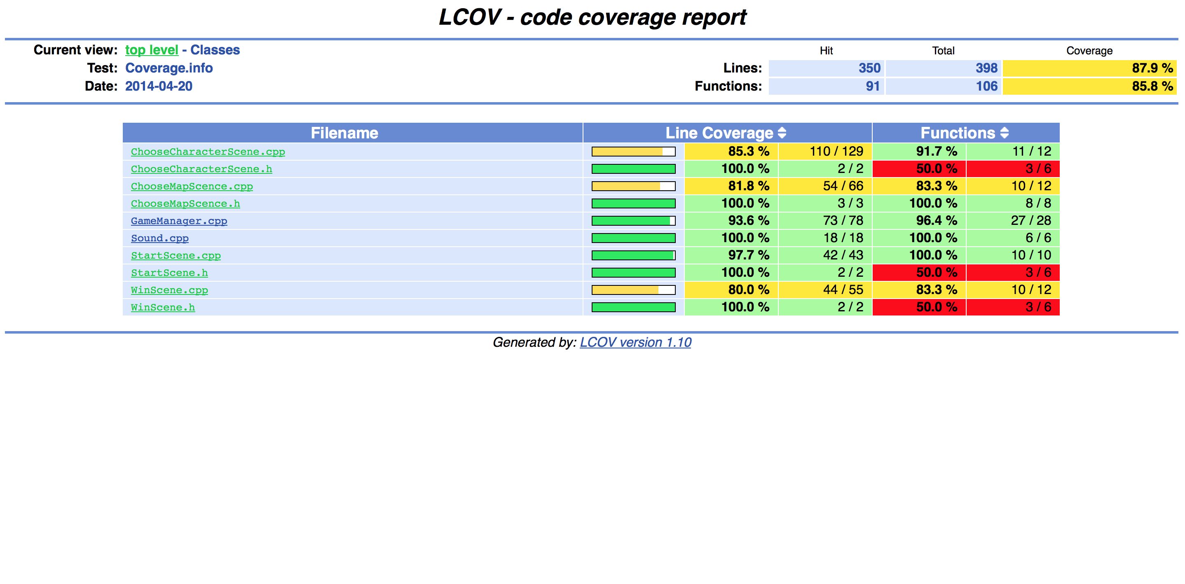
TEST COVERAGE

Slide 23
STATIC SOURCE CODE ANALYSIS
Using LLVM 3.4

Slide 24
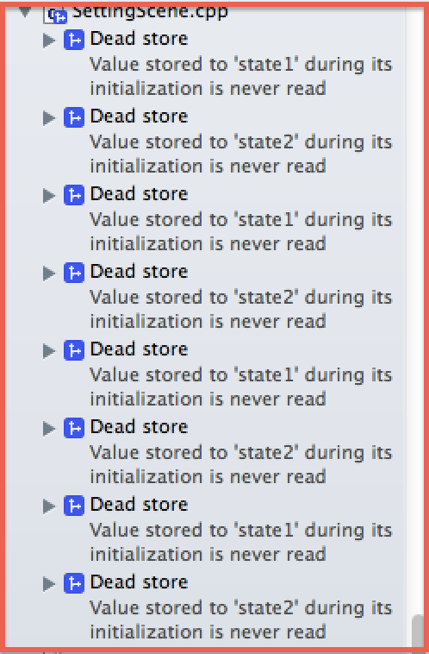
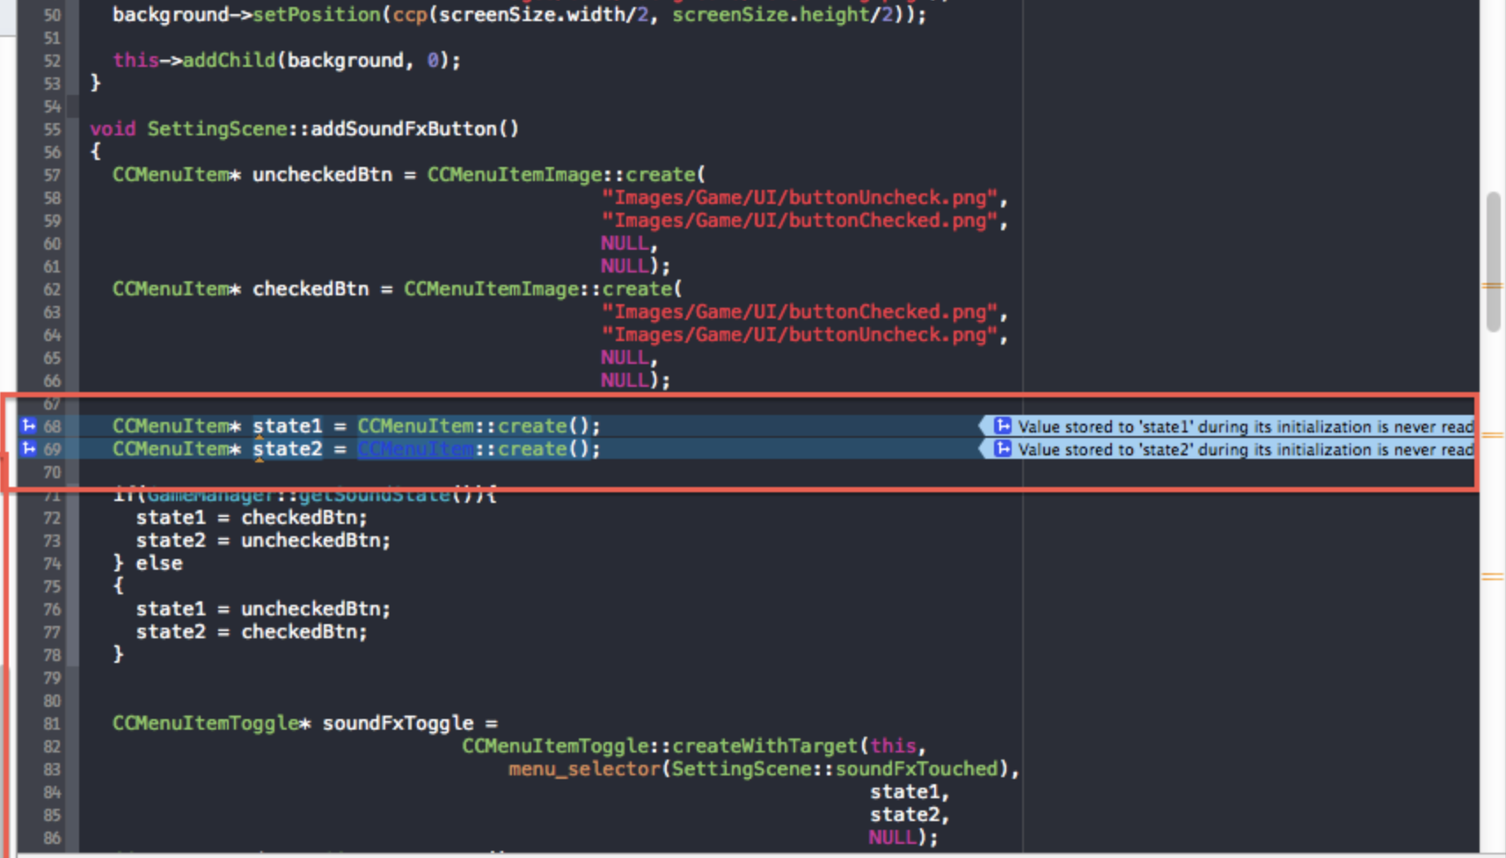
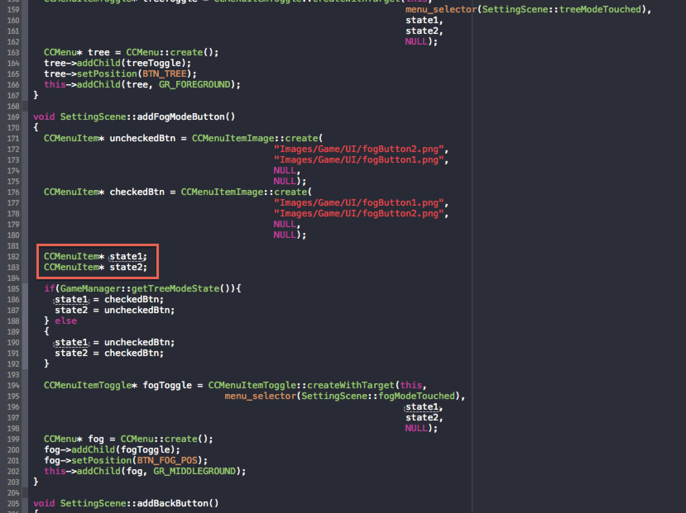

Slide 25
SYSTEM'S ARCHITECTURAL BLUEPRINTS
Unified Modeling Language (UML)

Slide 27
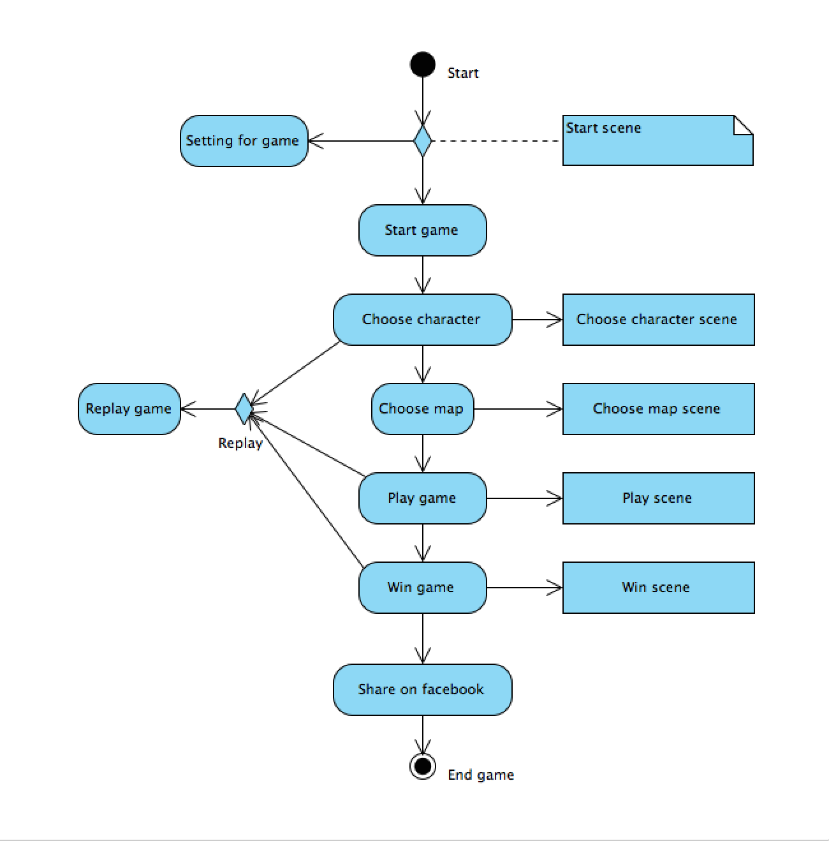
ACTIVITY DIAGRAM

Slide 28
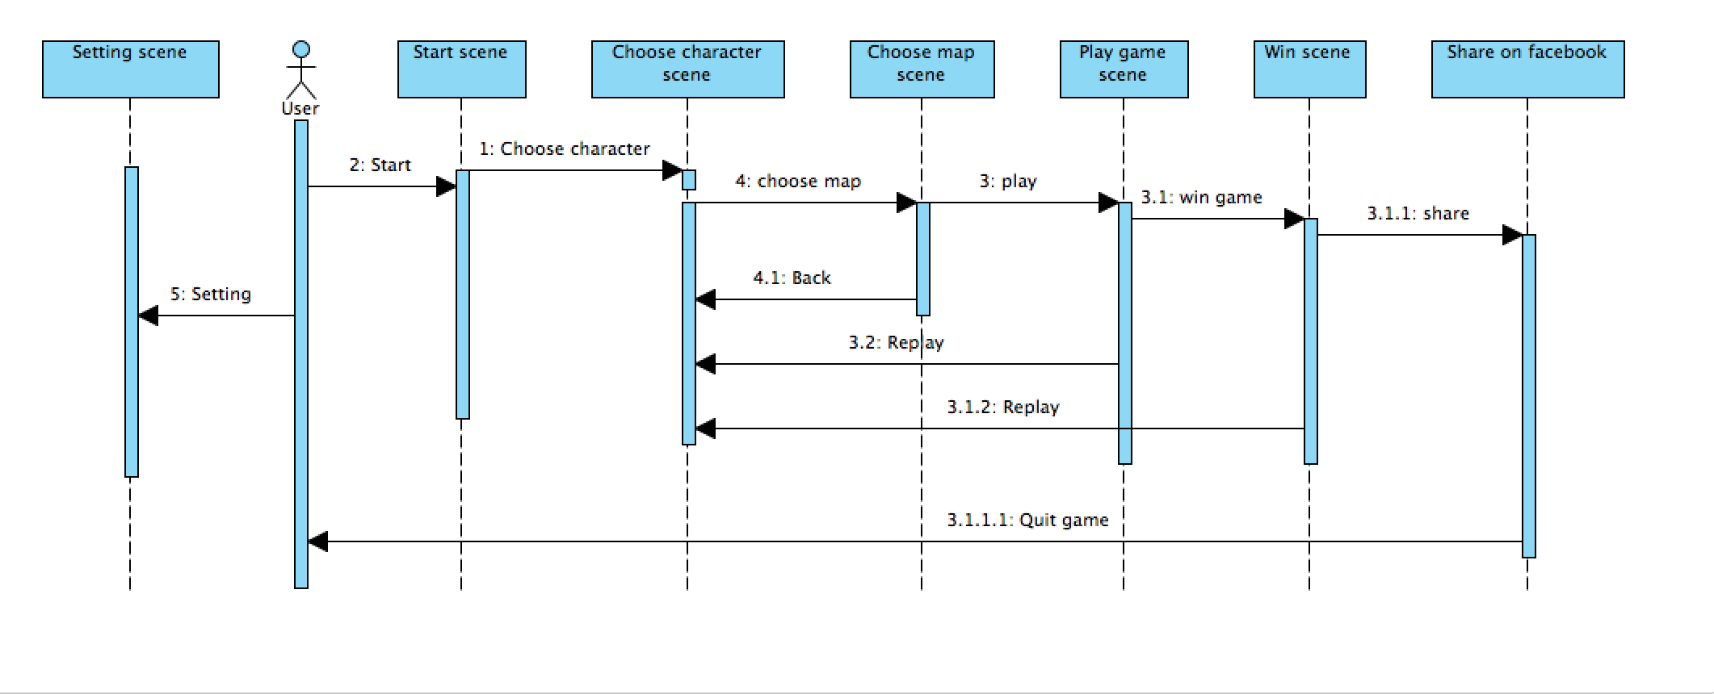
SEQUENCE DIAGRAM

Slide 29
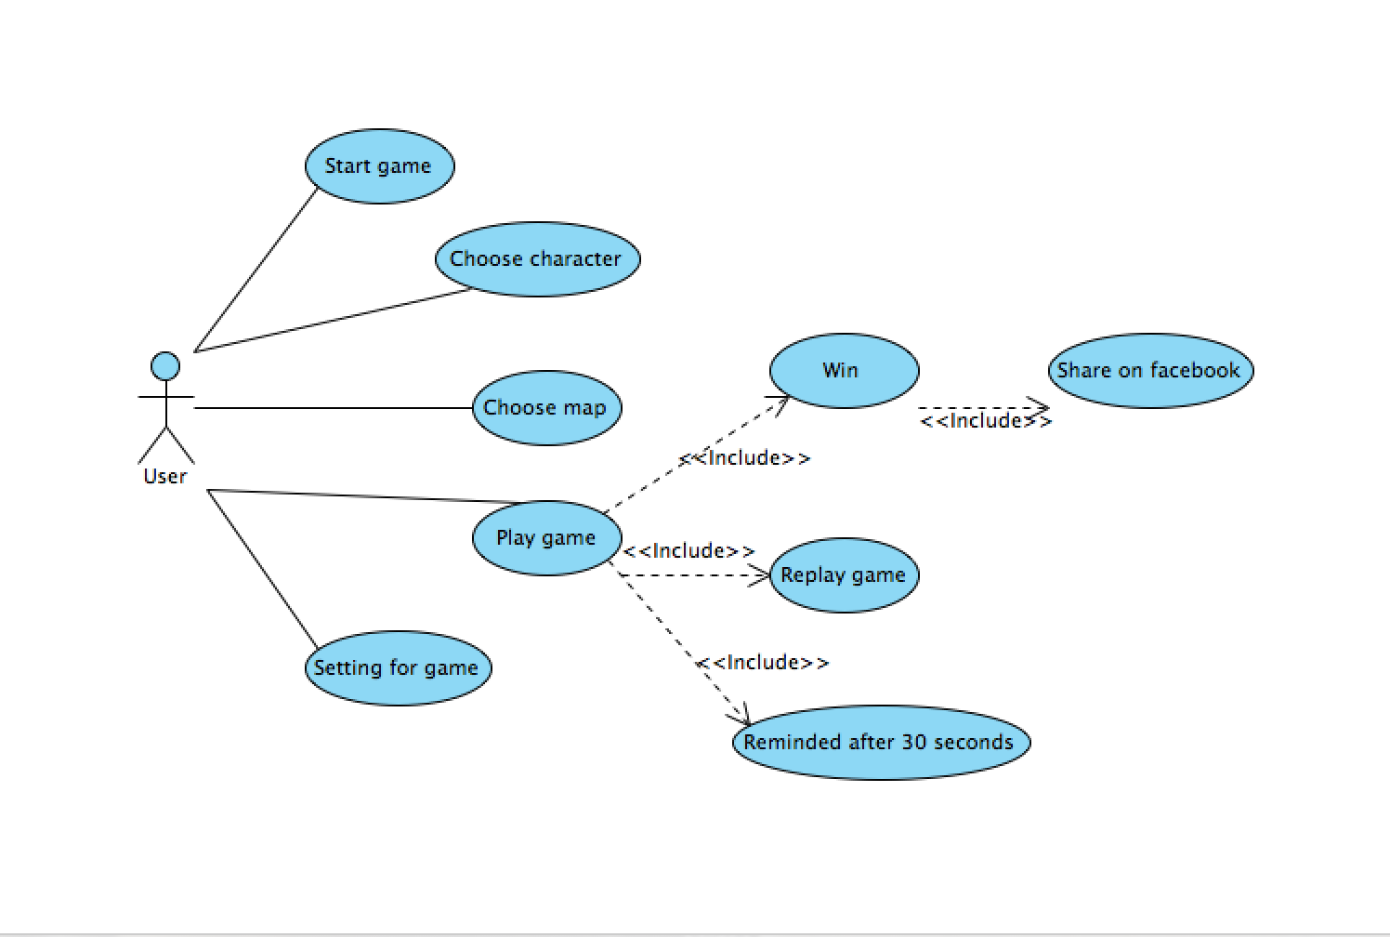
USER CASE DIAGRAM

Slide 30
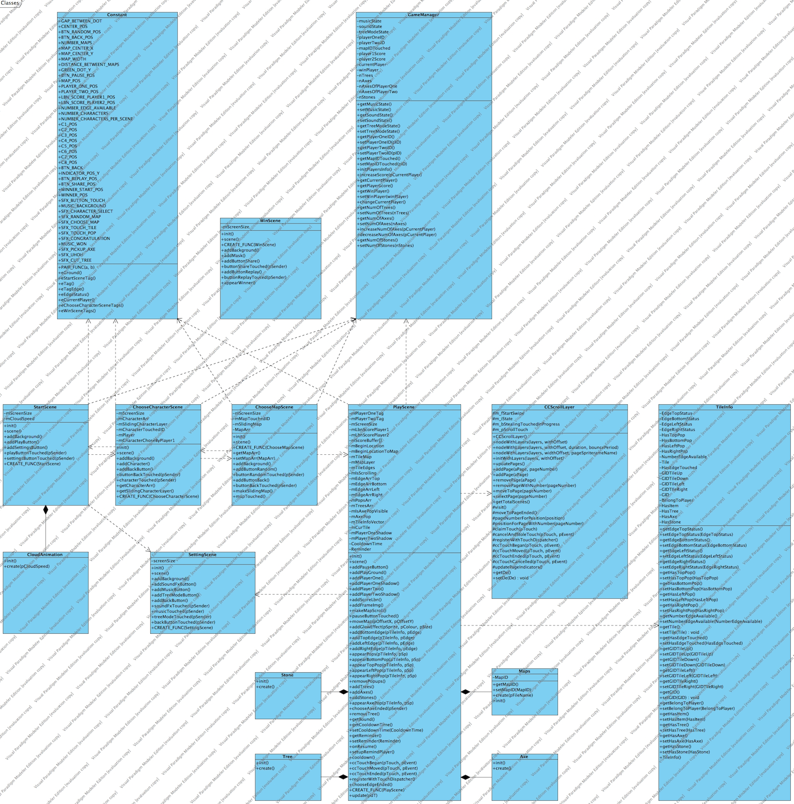
CLASS DIAGRAM

Slide 31
RELEASE
V0.1

Slide 32
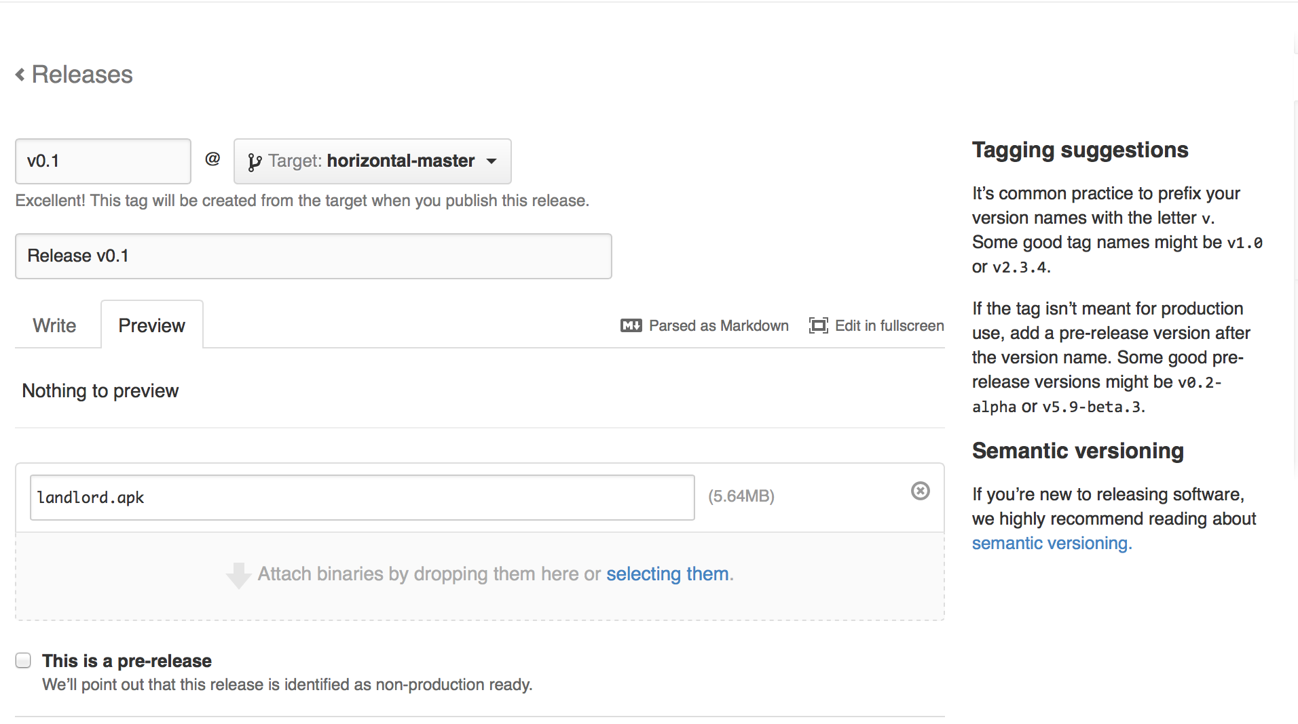
v0.1

